Slide 1
Data Science Methodology
30-6-2024

Slide 2

Course Overview
If there is a shortcut to becoming a Data Scientist, then learning to think and work like a successful Data Scientist is it.
In this course, you will learn and then apply this methodology that you can use to tackle any Data Science scenario.
You’ll explore two notable data science methodologies, Foundational Data Science Methodology, and the six-stage CRISP-DM data science methodology and learn how to apply these data science methodologies.

Slide 3
Content
Problem Formulation
Data Collection and Analysis
Model Building and Deployment
Iterative Feedback and Improvement

Slide 4



Steps
From Problem to Approach and from Requirements to Collection
From Understanding to Preparation and from Modeling to Evaluation
From Deployment to Feedback
Remember: the stages of this methodology are iterative!

Slide 5
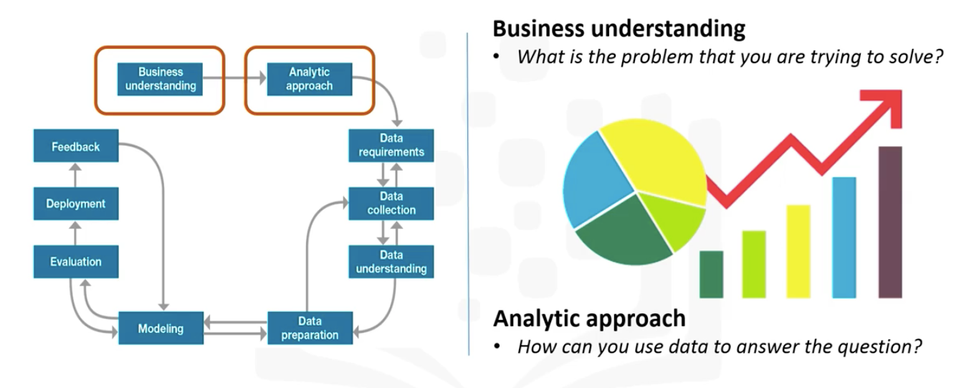
From Problem to Approach
Understand the question and business goals.
Identify the most effective analytic approach.
Importance of business understanding and engaging stakeholders.

Slide 6
Business Understanding
Define the problem.
Clarify the goals and objectives.
Engage stakeholders for requirements and support.

Slide 7
Business Understanding
What is the problem that you are trying to solve?
Establishing a clearly defined question starts with understanding the GOAL of the person who is asking the question.
Once the goal is clarified, the next piece of the puzzle is to figure out the objectives that are in support of the goal.
By breaking down the objectives, structured discussions can take place where priorities can be identified in a way that can lead to organizing and planning on how to tackle the problem. Depending on the problem, different stakeholders will need to be engaged in the discussion to help determine requirements and clarify questions.
Note: The key business sponsor's involvement throughout the project was critical, in that the sponsor: Set overall direction Remained engaged, and provided guidance. Ensured necessary support, where needed.

Slide 8
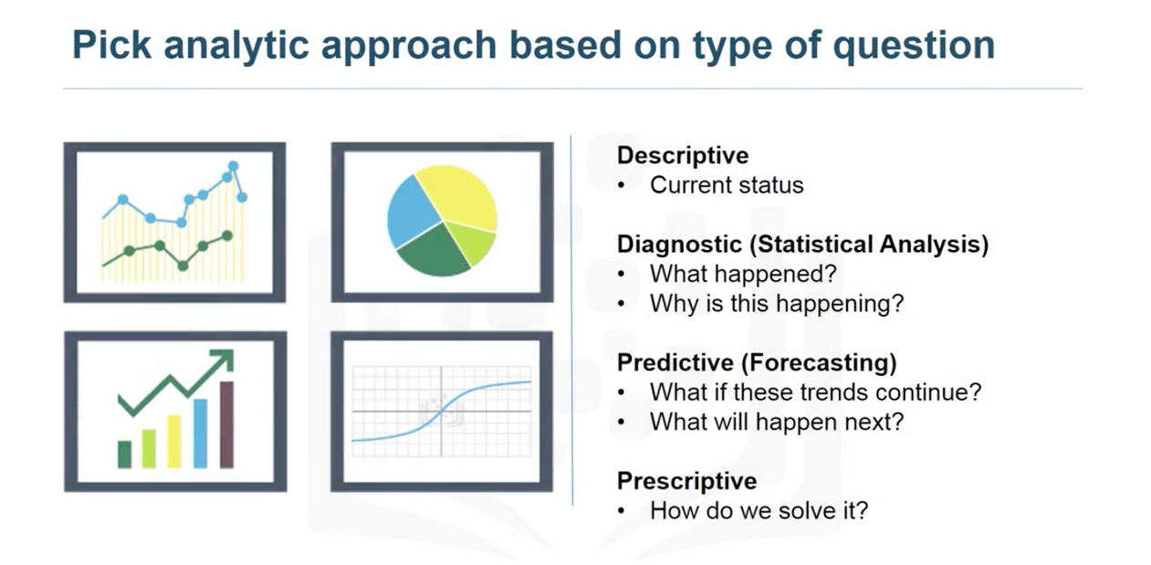
Analytics Approach
How can you use the data to answer the question?
Selecting the right analytic approach depends on the question being asked.
Once the problem to be addressed is defined, the appropriate analytic approach for the problem is selected in the context of the business requirements.
This is the second stage of the data science methodology.

Slide 9

Analytics Approach
If the question is to determine the probabilities of an action, then a predictive model might be used.
If the question is to show relationships, a descriptive approach maybe be required.
Statistical analysis applies to problems that require counts: if the question requires a yes/ no answer, then a classification approach to predicting a response would be suitable.

Slide 10

Data Requirements

Slide 11
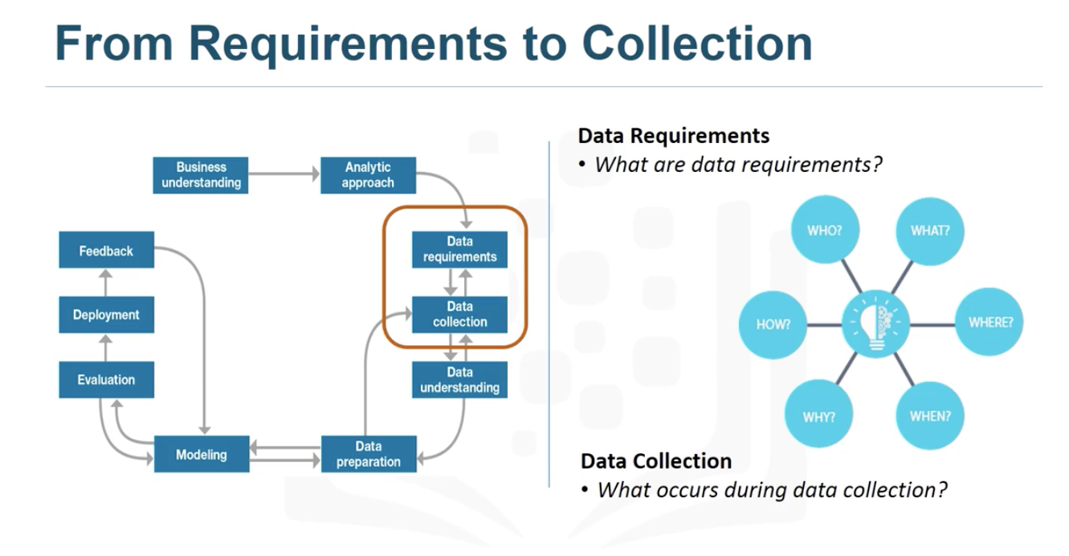
Data Requirements
If the problem that needs to be resolved is "a recipe", so to speak, and data is "an ingredient", then the data scientist needs to identify:
which ingredients are required.
how to source the data or collect them.
how to understand or work with the data
and how to prepare the data to meet the desired outcome.

Slide 12
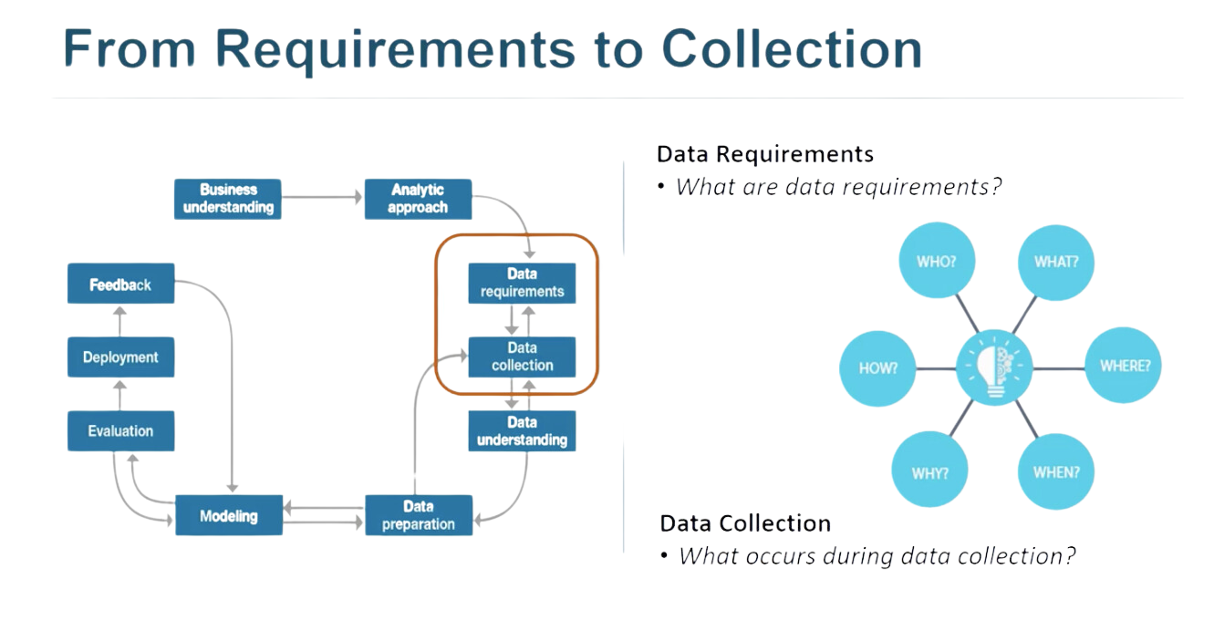
Data Requirements
Before proceeding with the methodology's data collection and preparation stages, it is crucial to define the data requirements specific to your use case and the models intended for training.
This includes:
Identifying Necessary Data:
Determine the content required for your analysis.
Specifying Data Formats:
Define the formats in which the data should be collected (e.g., CSV, JSON).
Determining Data Sources:
Identify the sources from which the initial data will be collected (e.g., databases, APIs, web scraping).

Slide 13

Data Collection
In this phase, the data requirements are revised, and decisions are made about whether the collection requires more or less data.
Once the data ingredients are collected, then in the data collection stage, the data scientist will have a good understanding of what they will be working with.

Slide 14
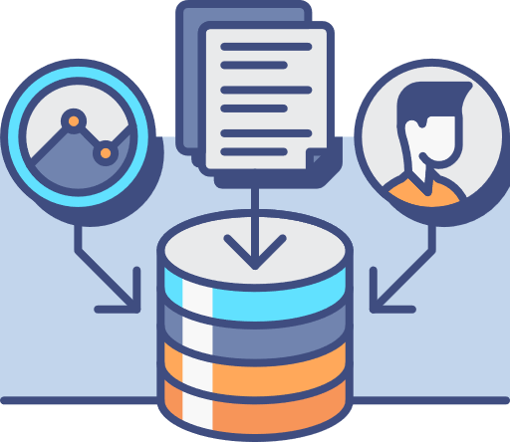
Data Collection
Techniques such as descriptive statistics and visualization can be applied to the data set, to assess the content, quality, and initial insights about the data. Gaps in data will be identified and plans to either fill or make substitutions will have to be made.
In essence, the ingredients are now sitting on the cutting board.

Slide 15
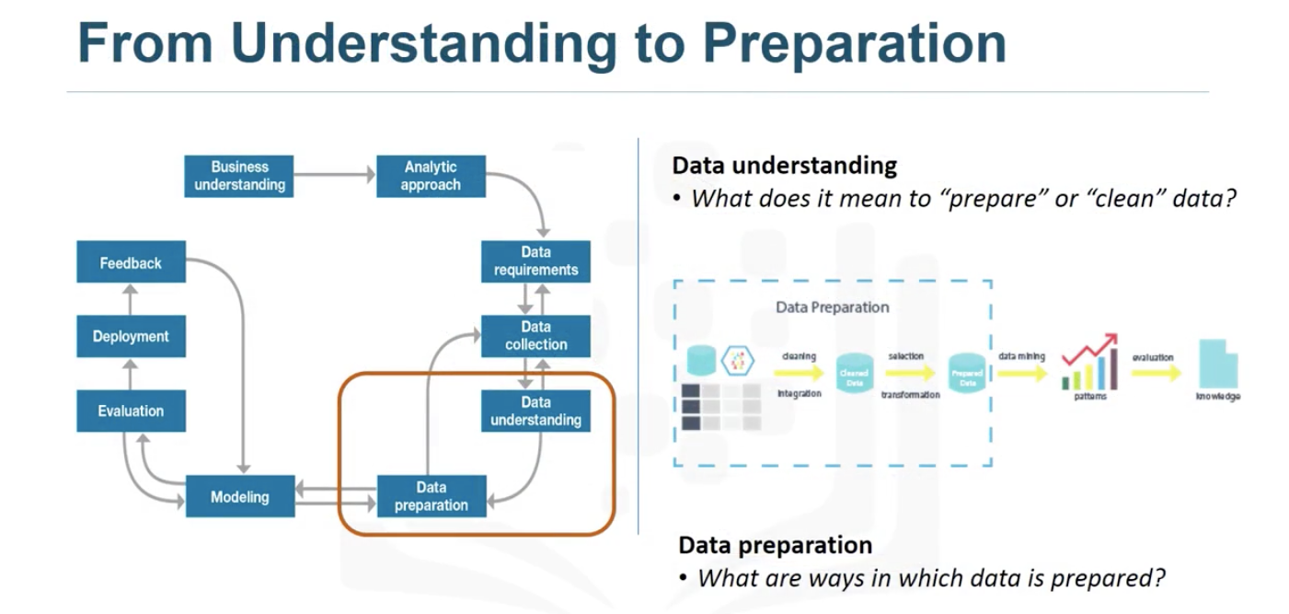
Step 2:
From Understanding to Preparation and from Modeling to Evaluation.

Slide 16

Data Understanding
Data understanding encompasses all activities related to constructing the data set.
Essentially, the data understanding section of the data science methodology answers the question:
Is the data that you collected representative of the problem to be solved?

Slide 17

Data Preparation
Clean and preprocess data to remove unwanted elements.
Handle missing values, duplicates, and formatting issues.
Perform feature engineering to enhance data for modeling.

Slide 18
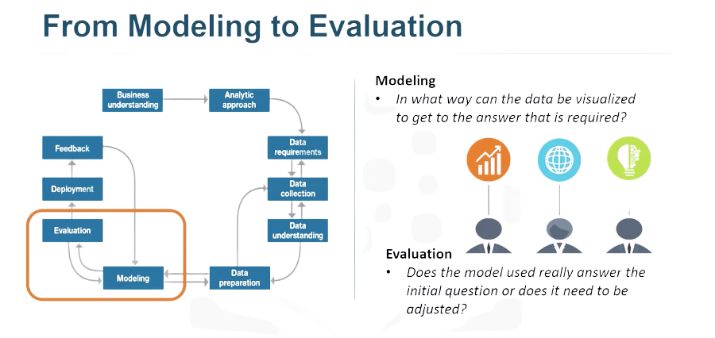

Slide 19

Modeling
Develop descriptive or predictive models.
Use training sets for predictive modeling.
Experiment with different algorithms and refine the model.

Slide 20
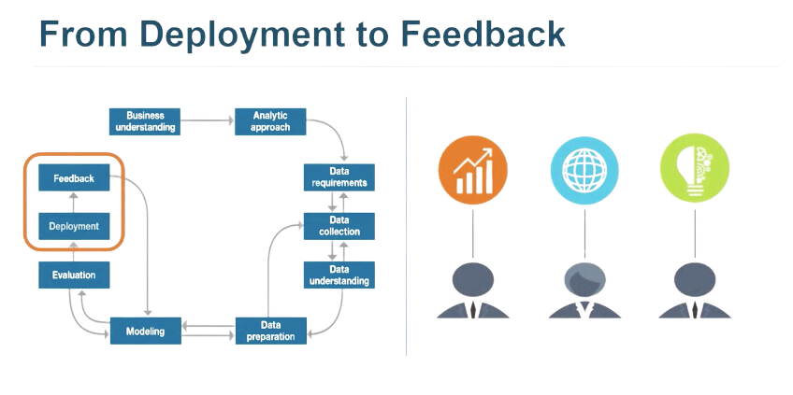

Slide 21
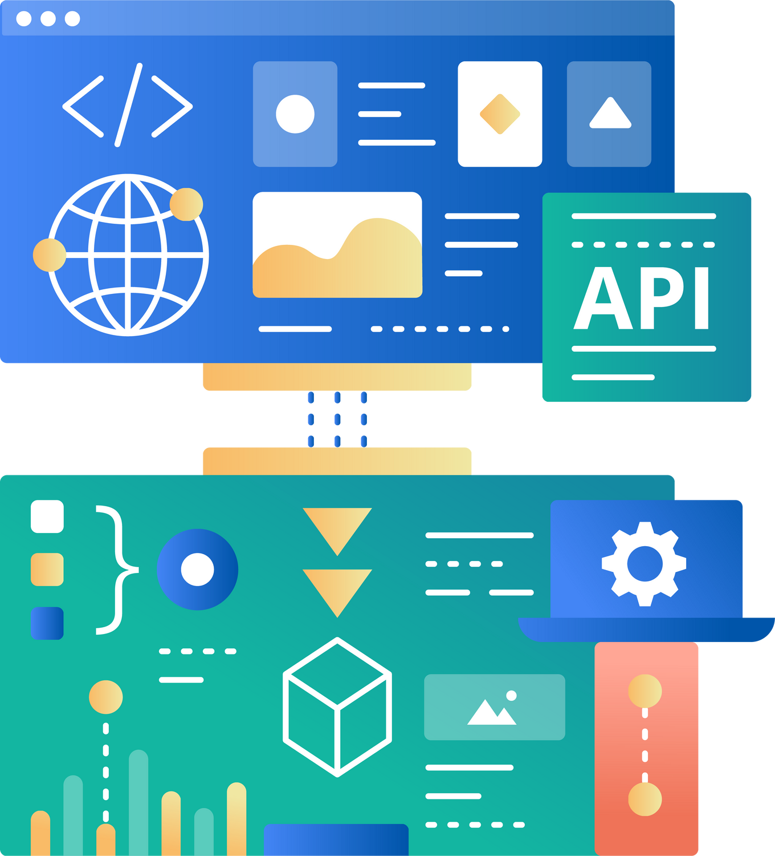
Deployment
Once the model is evaluated and the data scientist is confident it will work,
it is deployed and put to the ultimate test.
Depending on the purpose of the model, it may be rolled out to a limited group of users or in a test environment, to build up confidence in applying the outcome for use across the board.

Slide 22

Feedback
Gather user feedback to refine the model.
Continuous improvement based on performance and impact.
Ensure the methodology is cyclical for ongoing refinement.

Slide 23
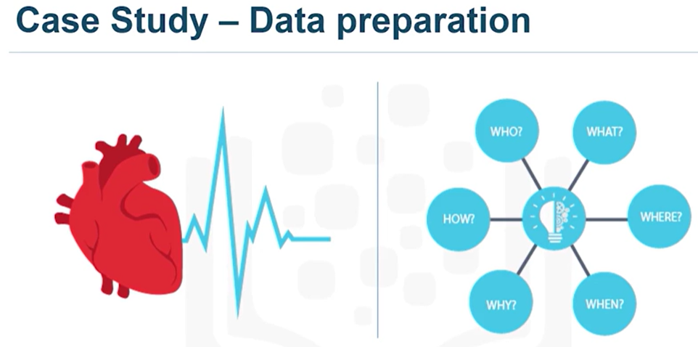

Slide 24
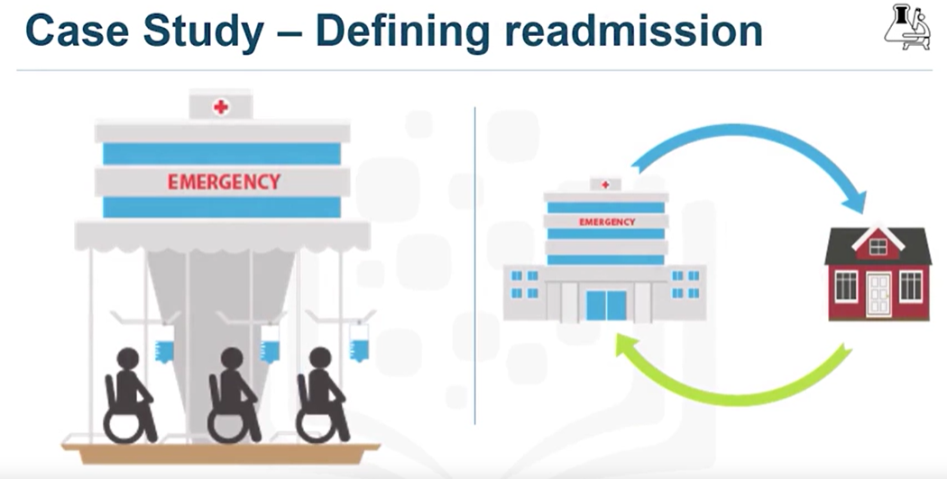

Slide 25
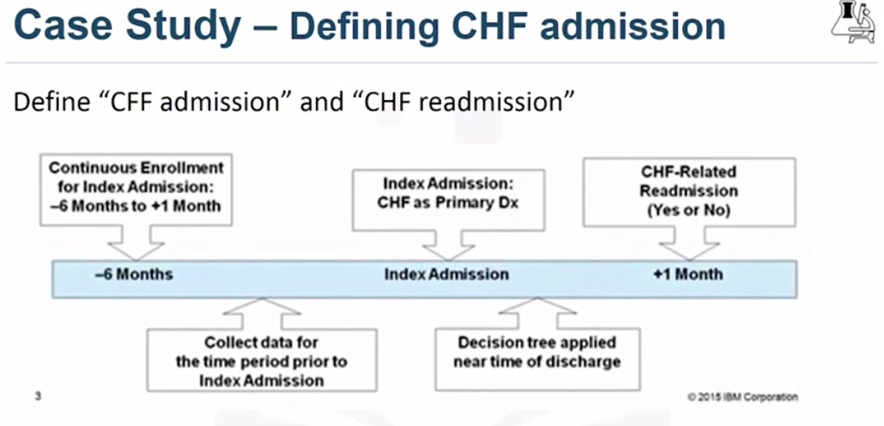

Slide 26
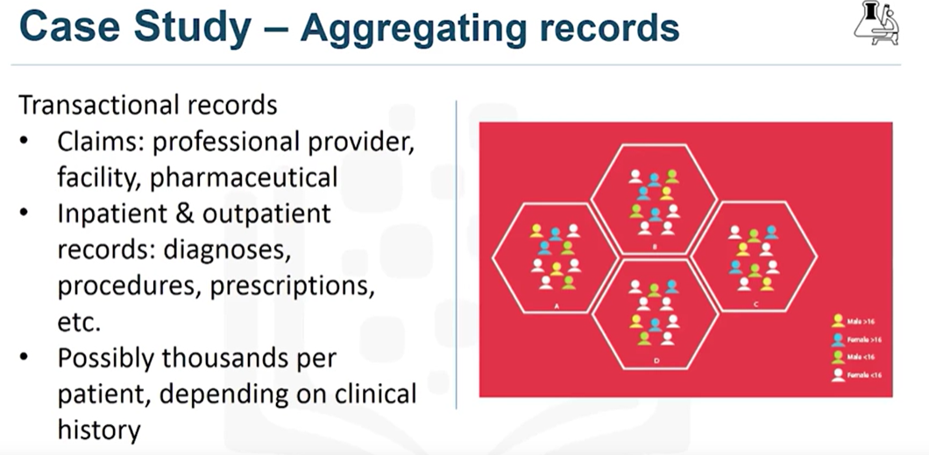

Slide 27
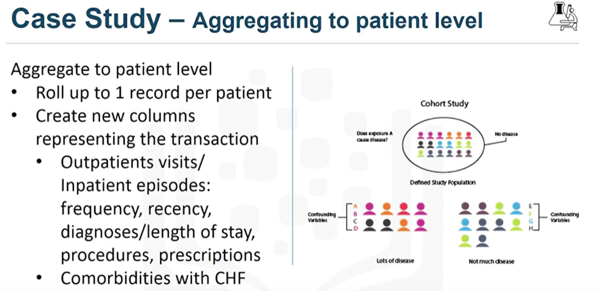

Slide 28
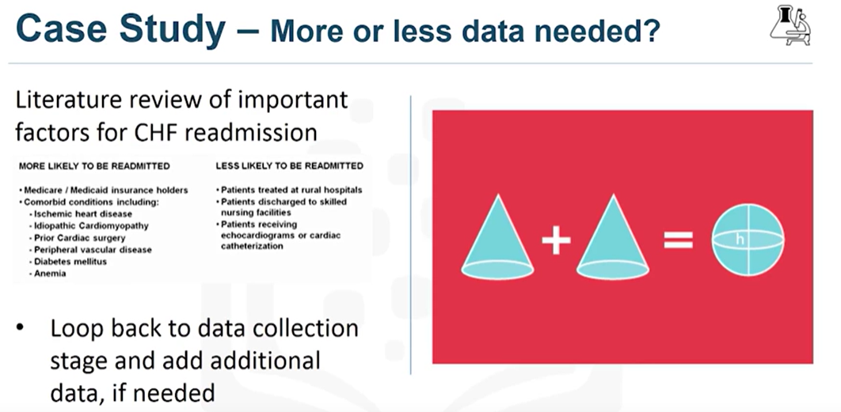

Slide 29
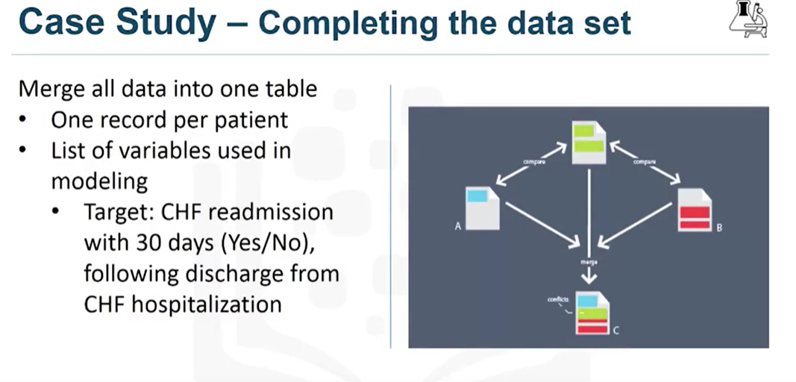

Slide 30
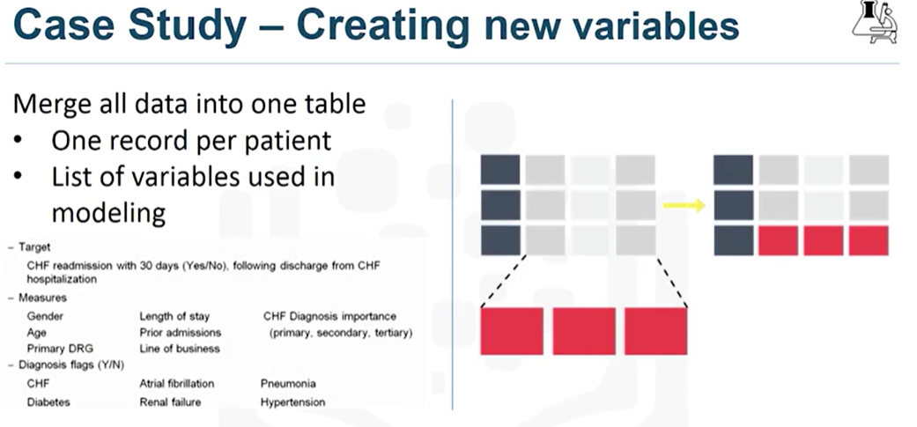

Slide 31
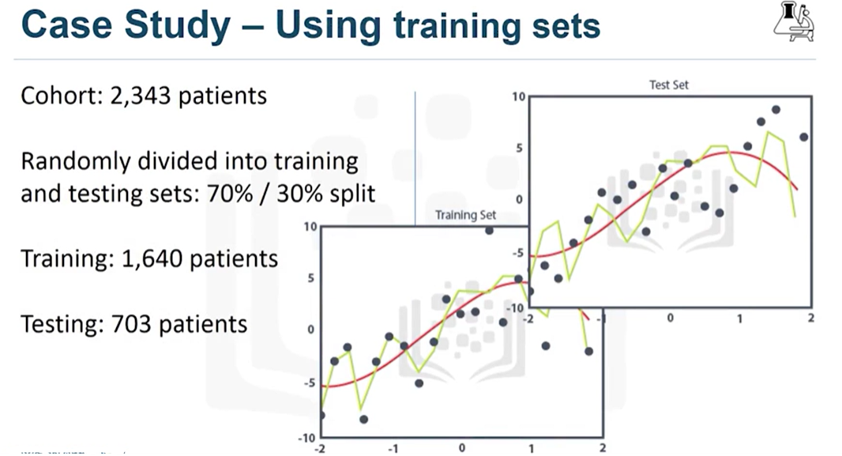

Slide 32
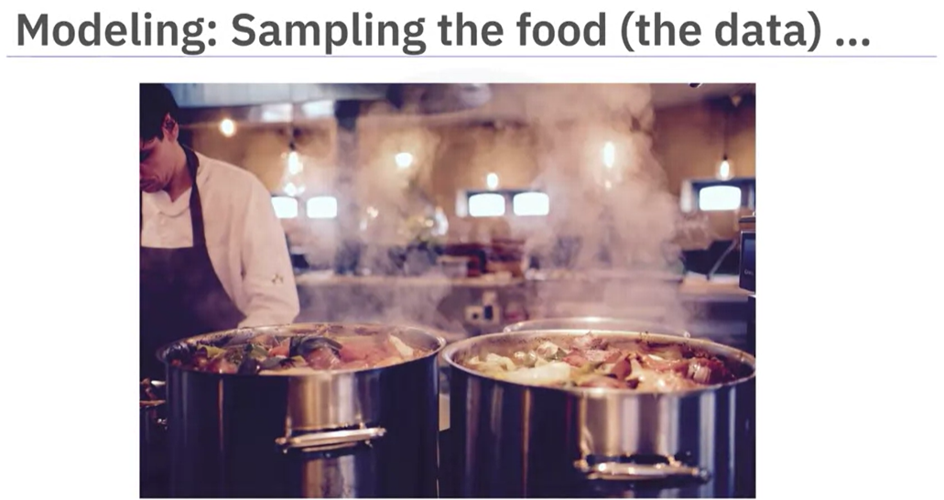

Slide 33
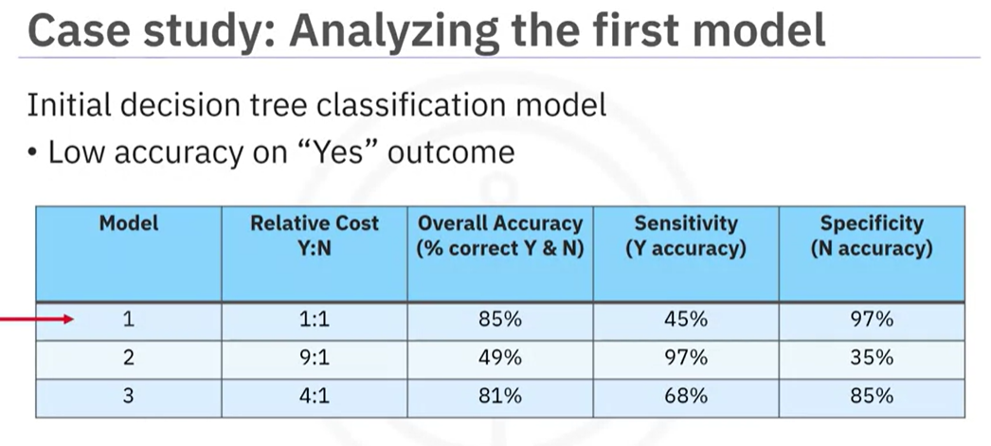

Slide 34
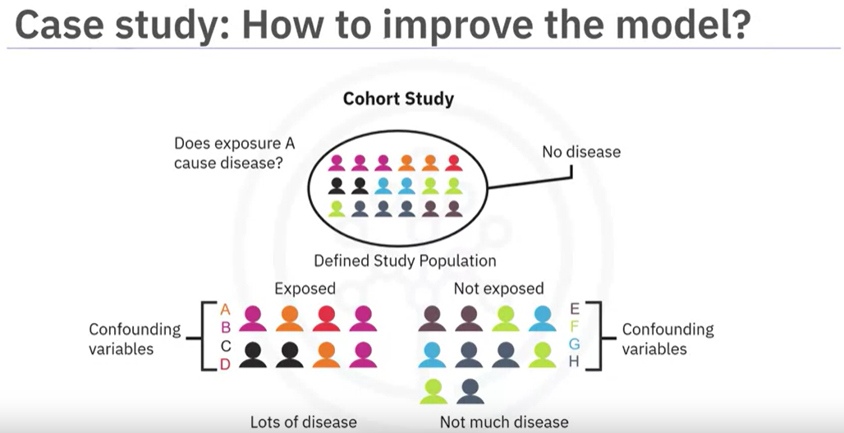

Slide 35
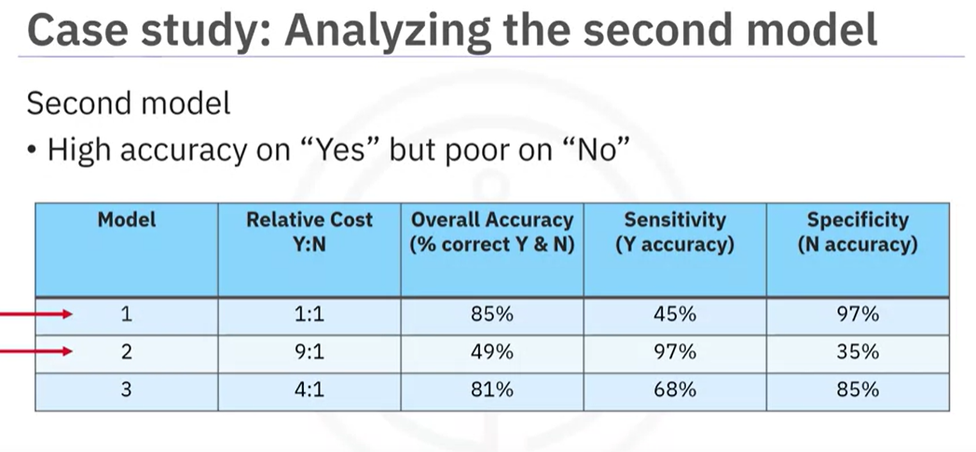
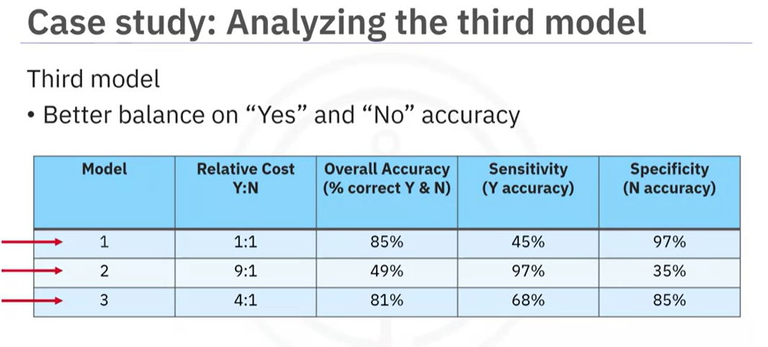

Slide 36

The Importance of Storytelling in Data Science

Slide 37
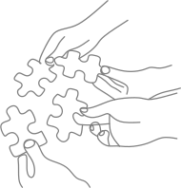
Why Storytelling Matters
Simplifies complex data.
Engages stakeholders and drives decision-making.

Slide 38

Elements of a Good Data Story
Clear objective and message.
Relevant data and insights.
Visuals that support the narrative.

Slide 39
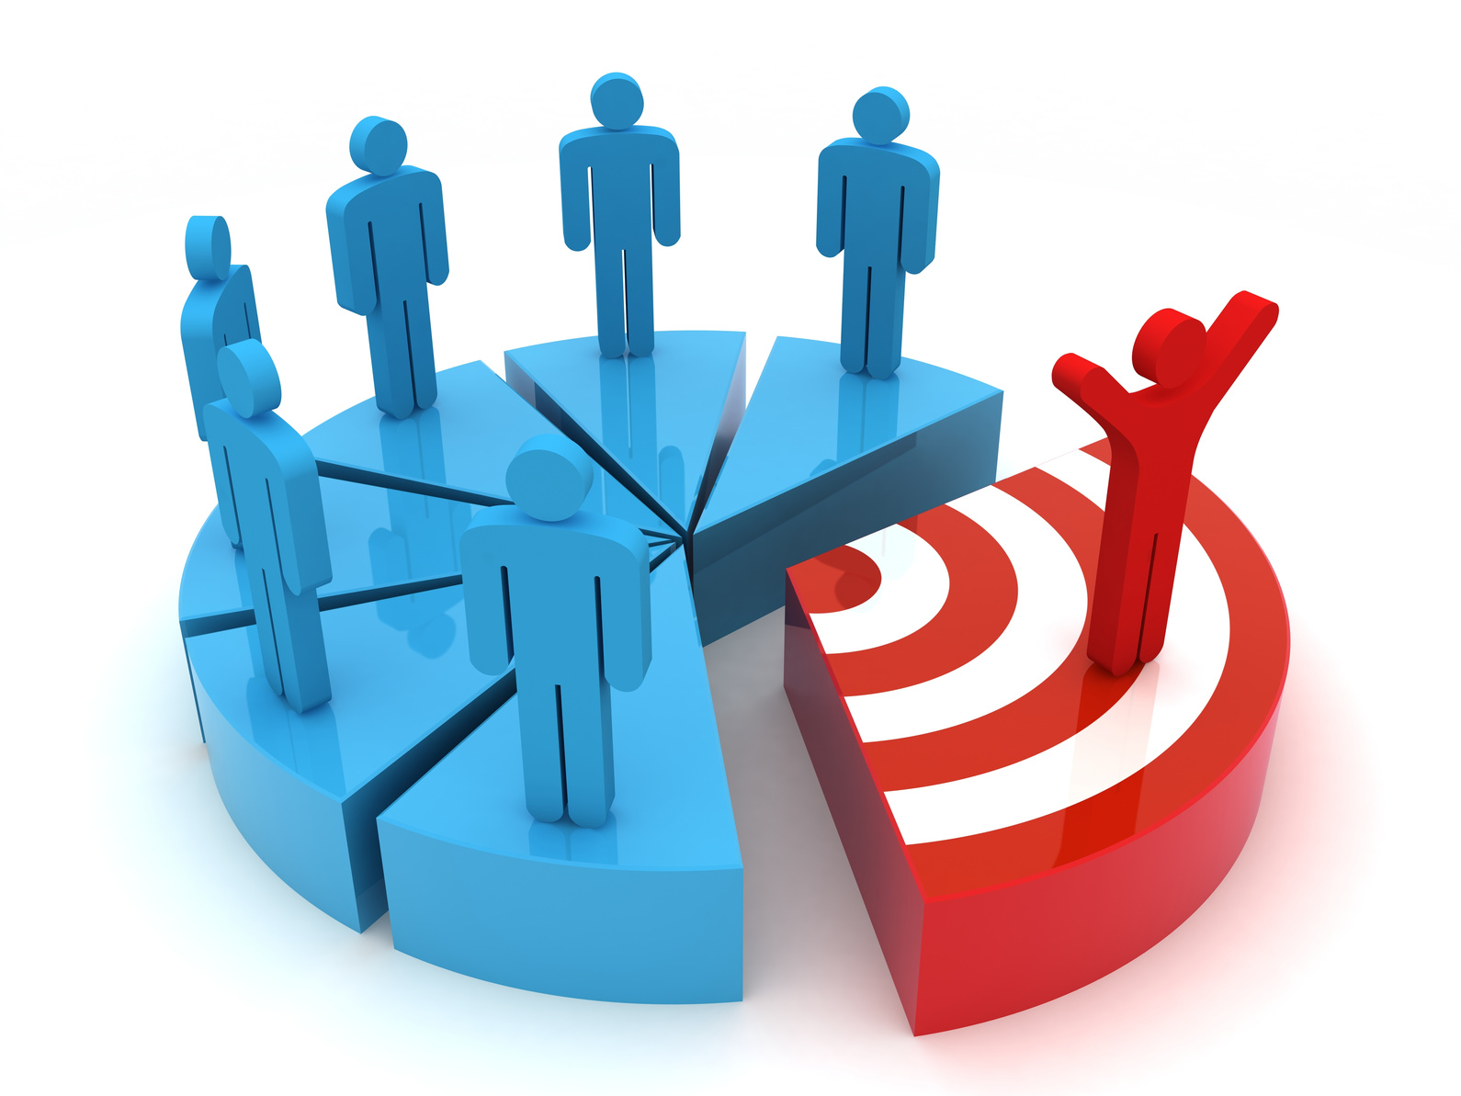


Tips for Effective Storytelling
Know your audience.
Craft a compelling narrative.
Use visuals to enhance understanding.
Iterate and refine based on feedback.

Slide 40




Questions & Answers
4/30/2024
34

Slide 41
Thank you!
4/30/2024
35

